Slide 1

INTRODUCTION TO OPTIMIZATION
CONVEX OPTIMIZATION PROBLEMS
-Convex Optimization Problems-

Slide 2
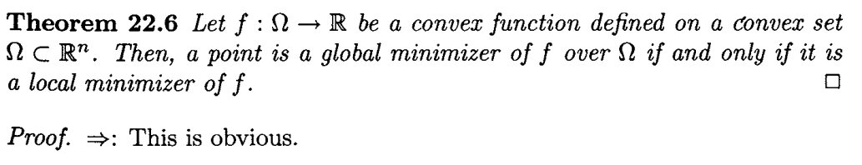

Convex Optimization Problems
we consider optimization problems where the objective function
is a convex function and the constraint set is a convex set.
Convex programming problems are interesting for several reasons.
1. Local minimizers are global for such problems.
2. First-order necessary conditions become sufficient conditions for minimization.
Local minimizer
Global minimizer
$$↔$$
First theorem above states that in convex programming problems, local minimizers are also global.

Slide 3
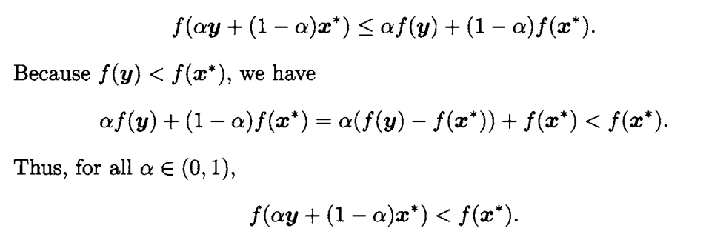
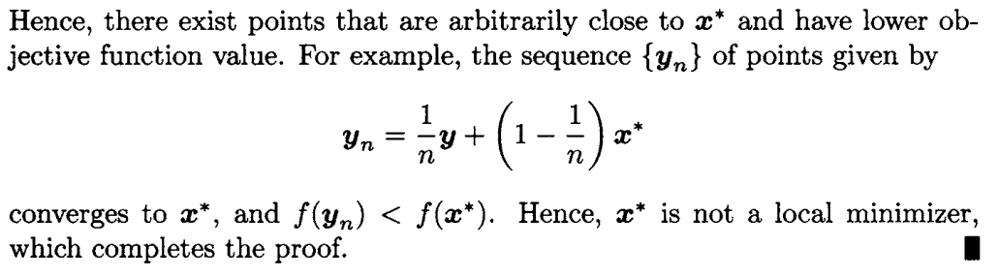










Prove by contraposition(대우).
Not a Global minimizer
Not a Local minimizer
$$↔$$
Suppose that $x^{∗}$is not a global minimizer of $f$ over Ω.
Then, for some $y$ $∈$ Ω, we have $f(y) < f(x^{∗}).$
the function $f$ is convex, and hence for all $α∈$ (0,1)
$$f(x)$$
$$f(x^{∗})$$
$$f(y)$$
$$f(α\left(y\right)+\left(1−α\right)x^{∗})$$
$$n→ ∞$$
$$y$$
$$x^{∗}$$
$$α\left(y\right)+\left(1−α\right)x^{∗}$$

Slide 4
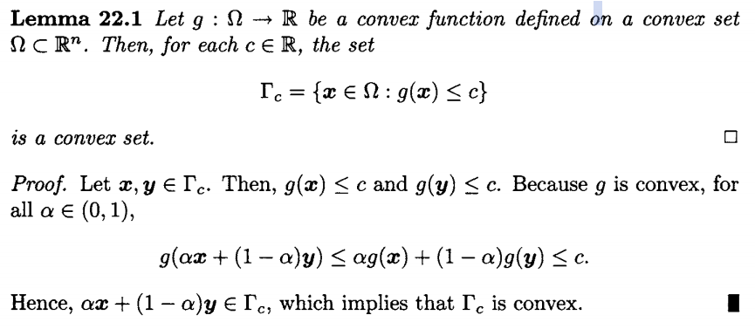
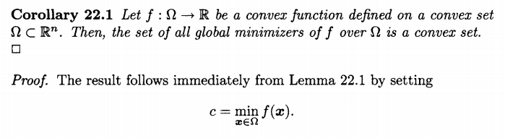
We now show that the set of global optimizers is convex. For this, we need the following lemma and Corollary.

Slide 5
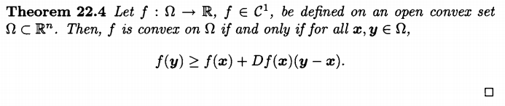
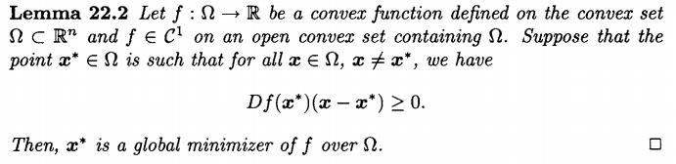
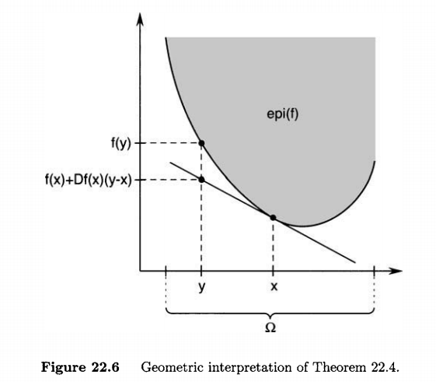
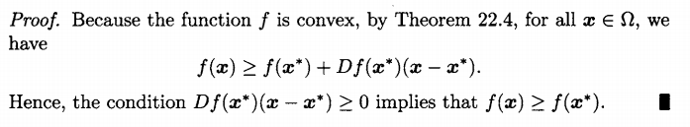
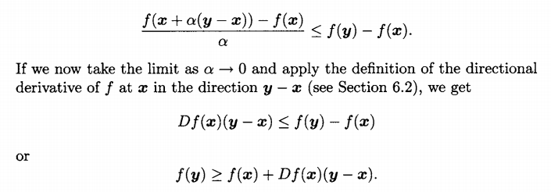
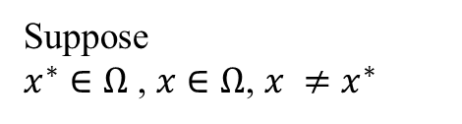

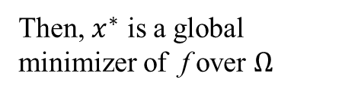
We now show that if the objective function is continuously differentiable and convex, then the first-order necessary condition (see Theorem 6.1) for a point to be a minimizer is also sufficient. We use the following lemma.
D : Jacobian matrix
Suppose
$x^{∗}∈Ω$ , $x∈Ω$, $x ≠x^{∗}$
Then, $x^{∗}$ is a global minimizer of f over $Ω$
$$y →x, x→x^{∗}$$

Slide 6
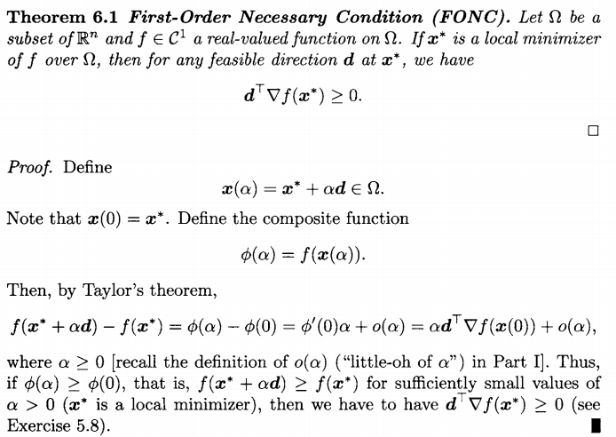

* 별지(Attached)
Taylor’s theorem
$$φ\left(α\right)= φ\left(0\right)+ φ^{′}\left(0\right)α+ ο(α)$$

Slide 7
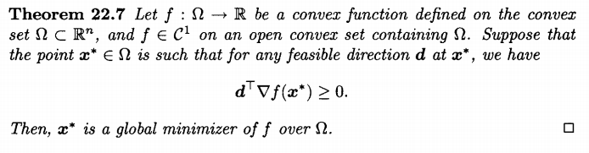
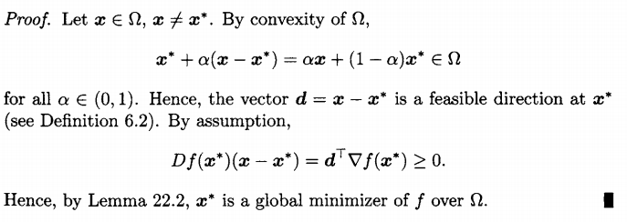

Slide 8
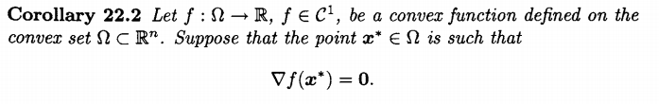
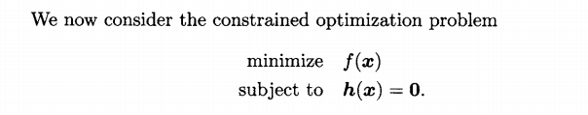
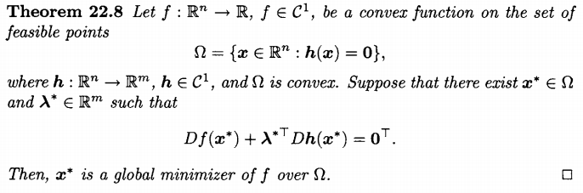

Slide 9
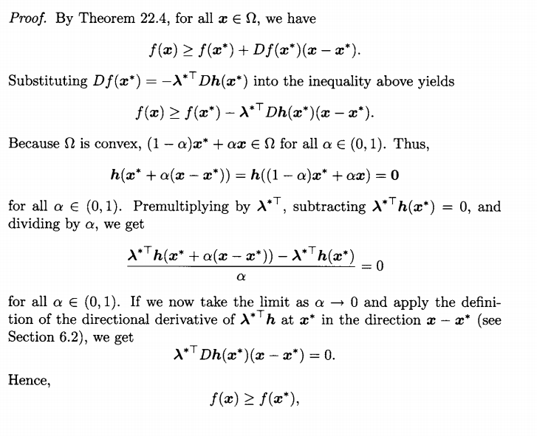

$$=$$

Slide 10
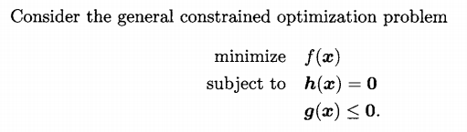
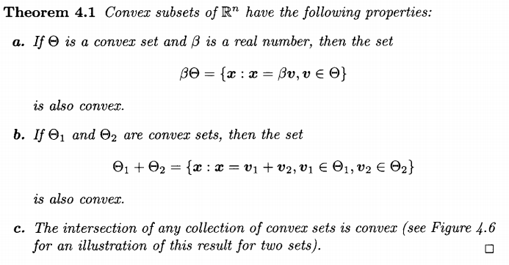
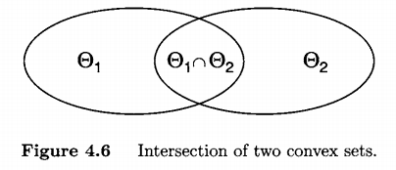
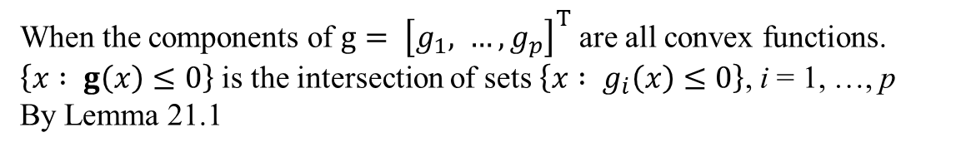
As before, we assume that the feasible set is convex.
This is the case if, the two sets $\left\{x : h\left(x\right)=0\right\}$ and $\left\{x : g\left(x\right)≤0\right\}$ are convex
$\left\{x : h\left(x\right)=0\right\}$, $\left\{x : g\left(x\right)≤0\right\}$ is convex.
When the components of $g= {\left[g_{1}, …, g_{p}\right]}^{T}$ are all convex functions.
$\left\{x : g\left(x\right)≤0\right\}$ is the intersection of sets $\left\{x : g_{i}\left(x\right)≤0\right\}$, i = 1, …, p
By Lemma 21.1
We now prove that the Karush-Kuhn-Tucker (KKT) condition is
sufficient for a point to be a minimizer to the problem above.

Slide 11
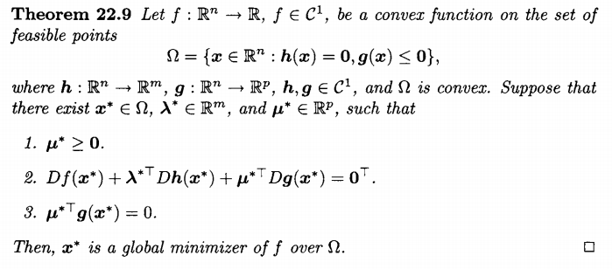
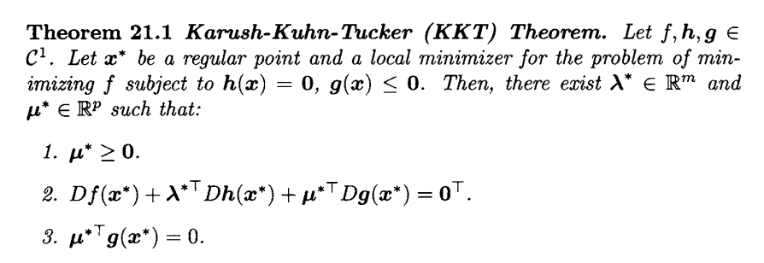



Slide 12
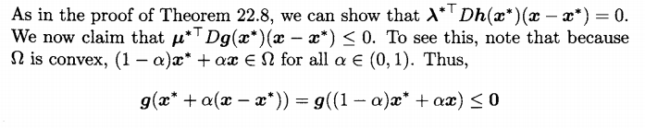
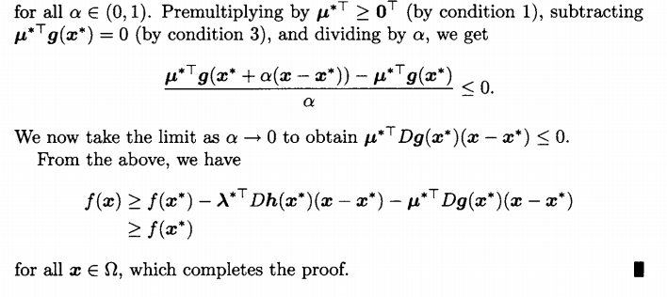



→ $\left\{x : g\left(x\right)≤0\right\}$ is convex.
$$=$$
$$f\left(x\right) − f(x^{∗})≥0$$

Slide 13
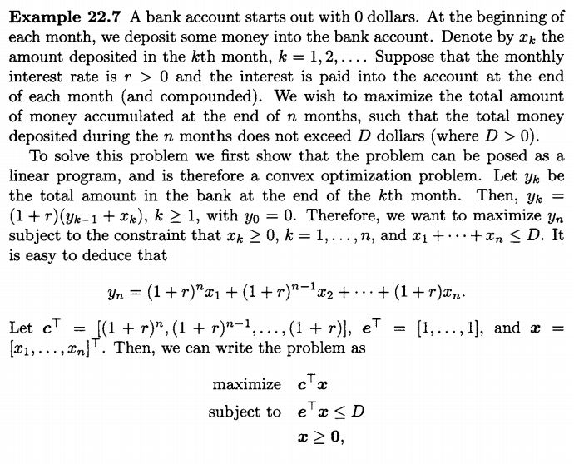
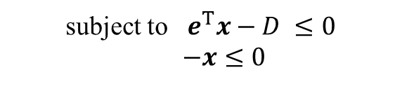

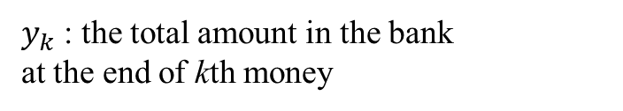
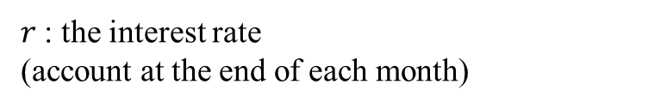

Problem is to maximize the total amount of money accumulated at the end of n month
$x_{k}$ : the amount deposited in the kth month
$r$: the interest rate
(account at the end of each month)
Total money deposited during the n months
does not exceed D dollar
$y_{k}$ : the total amount in the bank
at the end of kth money
minimize $−c^{T}x$
subject to $e^{T}x−D ≤0$
$−x≤0$

Slide 14
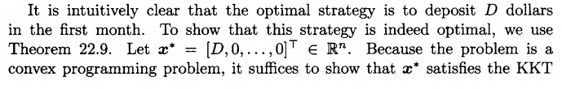












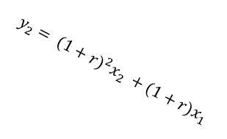
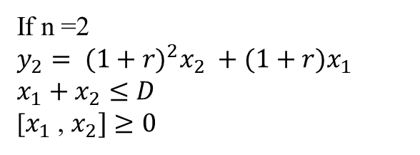
If n =2
$$y_{2}= {(1+r)}^{2}x_{2} +(1+r)x_{1}$$
$${x_{1}+x}_{2}≤D$$
[$x_{1}$, $x_{2}]≥0$
$$x_{2}$$
$$[D, 0]$$
$$D$$
$$y_{2}= {(1+r)}^{2}x_{2} +(1+r)x_{1}$$
$$feasible state$$
$$x_{1}$$

